Slide 1
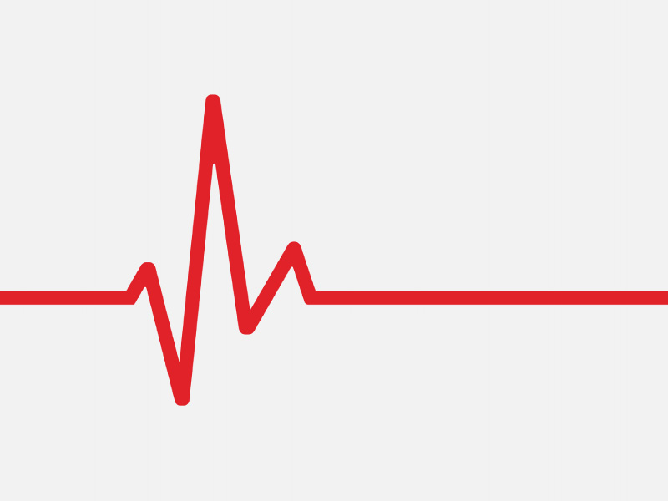

Zone Pulse AI Device
A Wearable PPG Heart Rate Watch
ENGR845 Term Project Presentation
Advisor: Dr. Xiaorong Zhang
Presented by: Ambika Madduri, Vrishika Mohite, & Arthur Wang

Slide 2

Table of Contents
Project Overview
Design Breakdown
Projected Outcomes
Results
Demonstration!

Slide 3

Project Overview
Why do we want to do this project?
Interest in a heart rate device.
Can be tricky to diagnose heart diseases.
Lack of more in-depth use of user data for cardiovascular health & exercising purposes.

Slide 4
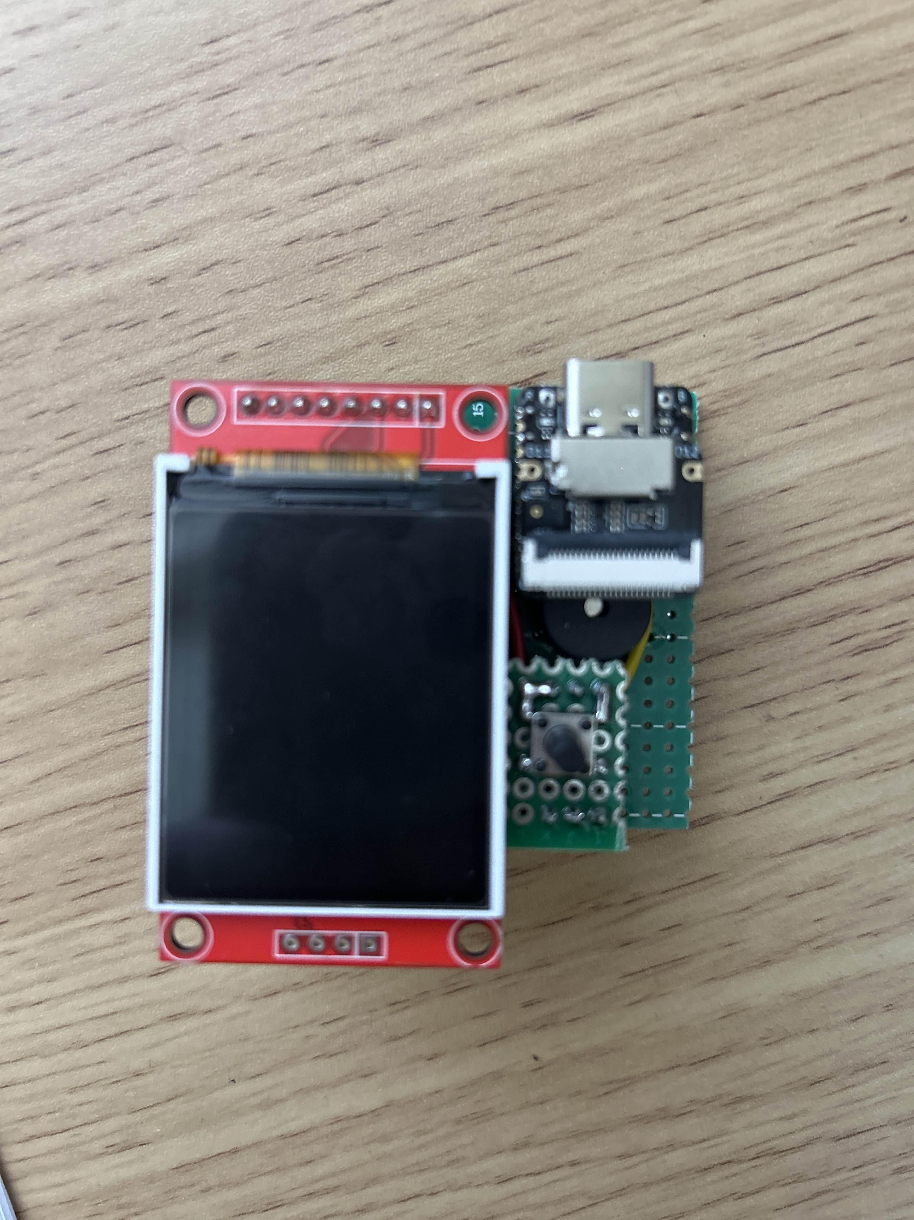
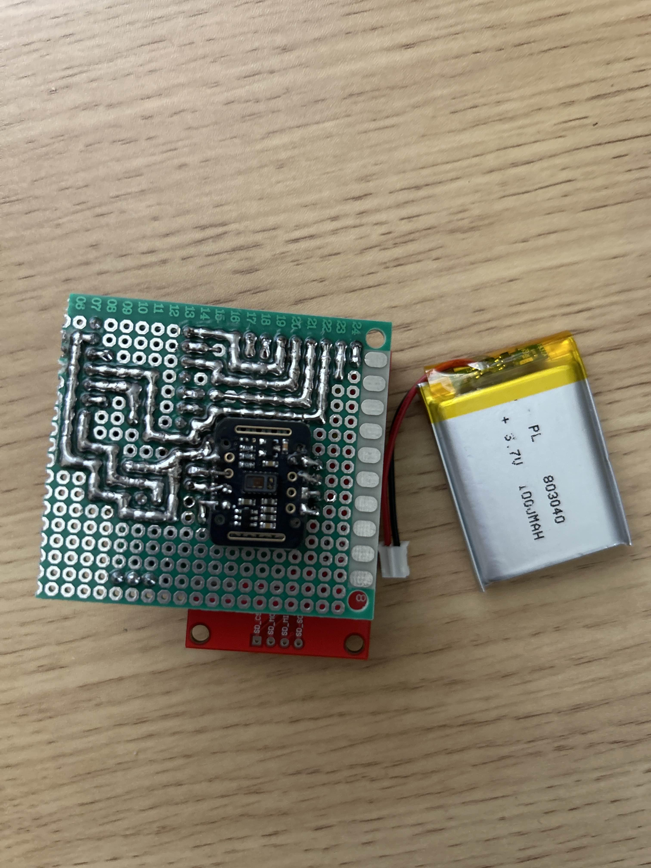
Project Overview
What does our project do?
Measure the user’s heart rate with a photoplethysmography (PPG) sensor
Uses the data to display the heart rate in beats per minute (BPM).
Integrated heart rate zones to indicate person’s effort into an exercise routine.

Slide 5
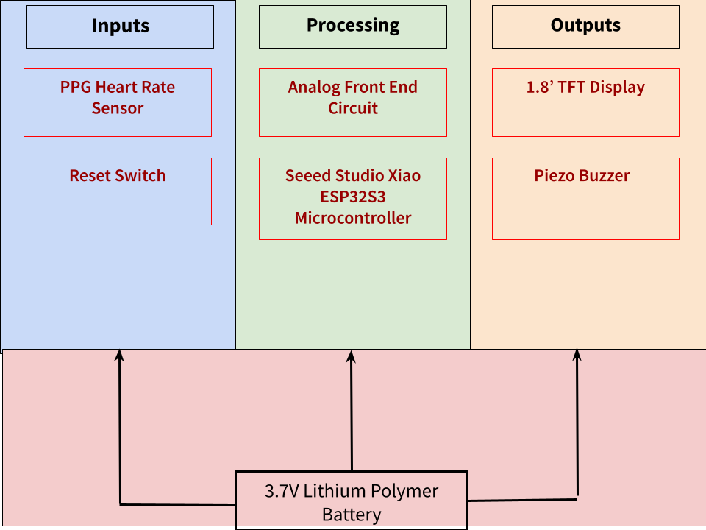
Design Breakdown
Internal Diagram

Slide 6
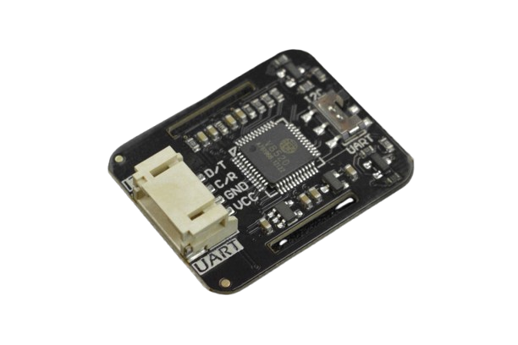
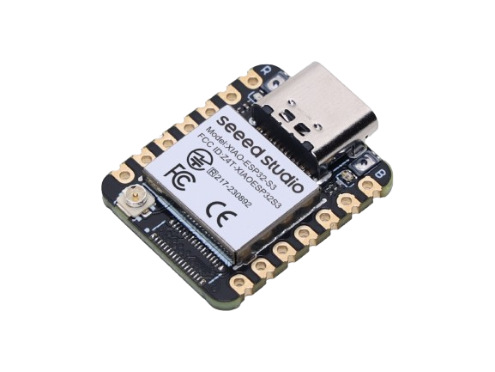
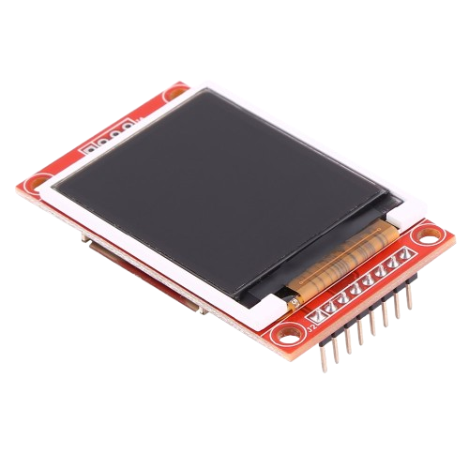
Design Breakdown
Major Components
MAX30102 PPG Heart Sensor
Seeed Studio Xiao ESP32S3
1.8’ TFT Display

Slide 7

Projected Outcomes
Potential Applications
More clear-cut exercise zones for more optimized outcomes.
Keep track of the user’s heart rate
Ideal for athletes, training, heart health, etc.

Slide 8

Projected Outcomes
Critical Aspects
Signal Reliability
System Performance
Heart Rate Measurement
Battery Life

Slide 9
Projected Outcomes
Experiments (How did we test it?)
Heart Rate Zone
To see if the device can differentiate a person’s heart rate zones based on the 5 heart rate zones.
Signal Consistency
Can it continuous monitor what zone is the user in?
Heart Rate
Rest
Light activity (5 to 10 mins of activity)
Battery Life
Monitor the time it takes till discharged
Usability
Test visibility of display and LED indicators in various lighting conditions.

Slide 10
Results
Detect the user’s heartrate successfully.
Rest
Light Activity
Battery Life is also very promising.
At least 6 hours of screen on-time
Usability is even bright enough for sunlight use.
Signals are fast enough to read the user’s heart rate and to monitor what zone it is.

Slide 11
Issues & Limitations
Test is very limited.
Assumes that you’re 25 years old and age must be adjusted.
Limited exercising data.
Signal noise is also a recurrent problem.
Sometimes, it may go up to Zone 2 or 3 erratically.
Gives real time zone reads, but can be too quick for the user to read
What else can we work on?
Acquire more exercising data
More activities or longer duration
Find a more seamless way to add age to testing
Address the noise problems within the sensor.

Slide 12

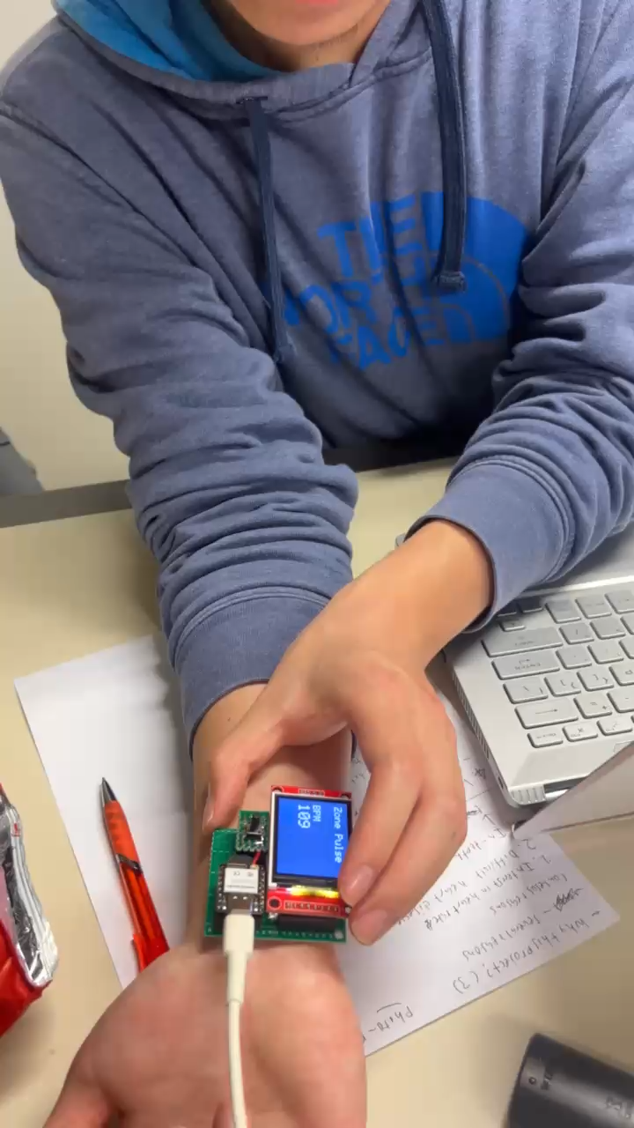
Demonstration!

